Slide 1
AUTONOMOUS DRONE CONTROL
SONGÜL MERYEM ÖZBİLEN 201711048
ELİF YAĞMUR ERATALAY 201811028
AHMET ÇETİN TÜRKYENER 201711066
Advisor: Prof. Dr. Ahmet Coşar

Slide 2
CONTENTS
01
PURPOSE
02
MAIN FEATURES
03
BUILDING
04
TESTS
05
DEMO

Slide 3
PURPOSE
Our aim in this project; to reveal a fully autonomous
unmanned aerial vehicle that will enable it to successfully
complete the test area by detecting the objects we have
defined previously in our dataset, reducing the risk of
accident.

Slide 4
MAIN FEATURES
Identification of objects to the data set by image processing
The autopilot decides how to act according to these objects
The main features of the system are to operate artificial intelligence, autopilot and image
processing software in an integrated manner and to ensure correct movements by providing correct
command transfer to the drone flight elements.

Slide 5
BUILDING
Hardware
Artificial Intelligence and Image Processing
Drone Motion Action
-Autopilot Communication (Writing SDK codes)

Slide 6
Hardware

Slide 7
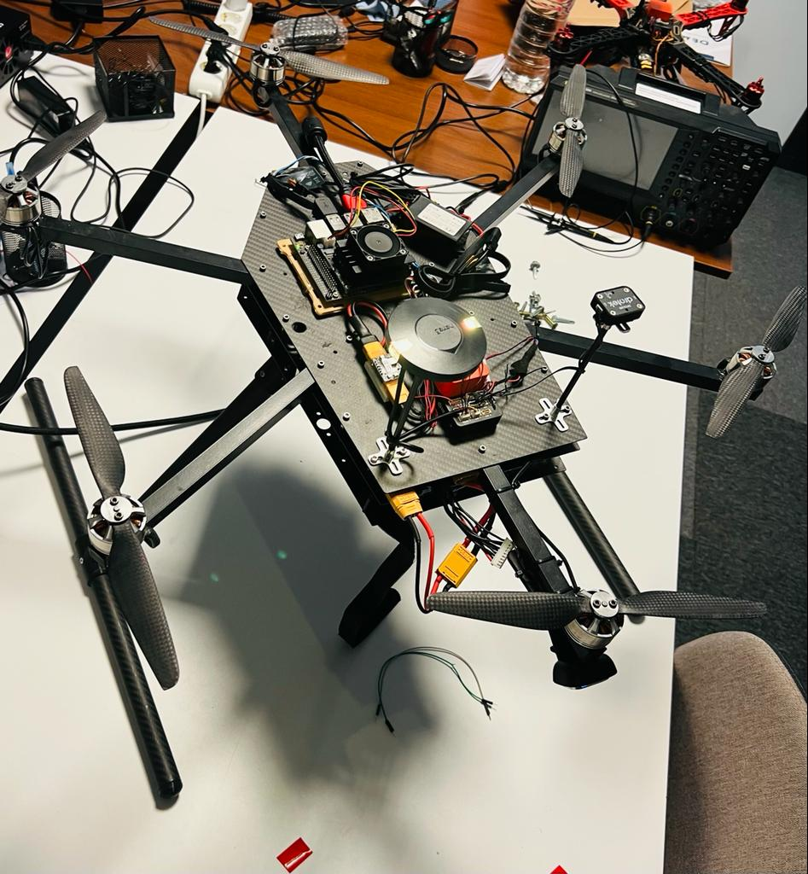
Hardware
Camera
GPS
Battery
Carbon Fiber Construction
Jetson Xavier
Pixhawk Autopilot

Slide 8
ARTIFICIAL INTELLIGENCE
AND
IMAGE PROCESSING
Preparing Dataset
Training Model
Object Detection

Slide 9
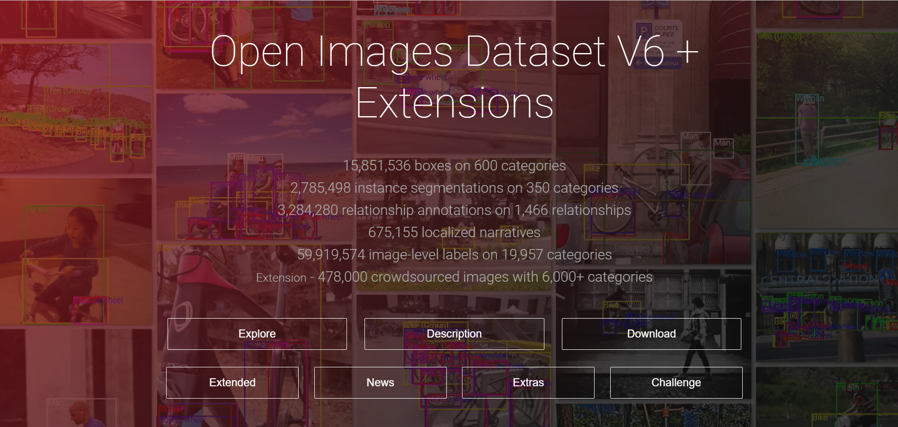
PREPARING DATASETS
https://storage.googleapis.com/openimages/web/index.html

Slide 10

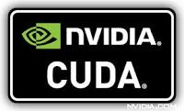

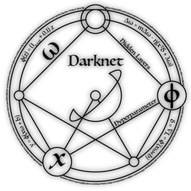
Training Model
What did we benefit from ?

Slide 11
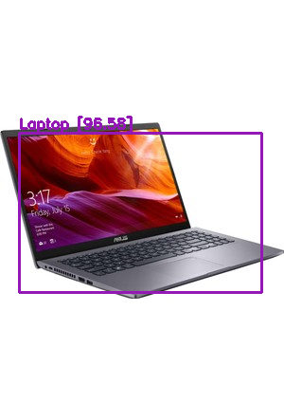
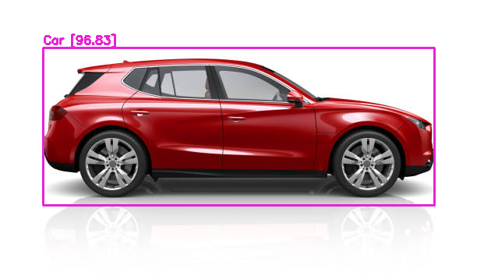
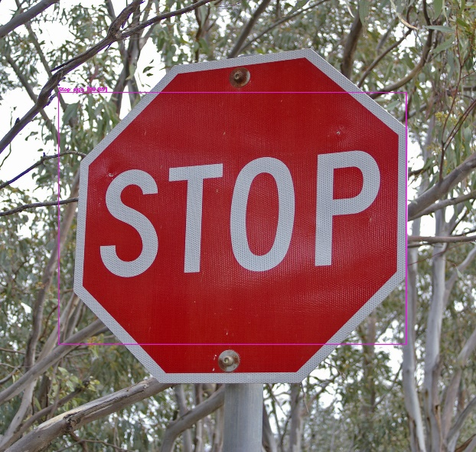
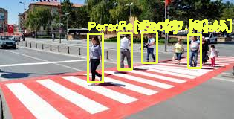
OBJECT DETECTION
Successful detection of the snapshot from the camera by our model.

Slide 12
AUTOPILOT

Slide 13

AUTOPILOT
Drones can be flown in many ways, such as command, autopilot, etc. In our project, the use of
autopilot was deemed appropriate and motion actions were provided in this way.
We used ardupilot as autopilot software.
We wrote functions according to our purpose in the project and contacted autopilot with mavlink
commands and got what we wanted.
We tested the control of the flight software we prepared with the misson planner application.
Mission planner is a simulation application of the ardupilot, this application allows us to perform
drone calibration and tests, so we reduce the risk of accident in our drone flight tests.

Slide 14
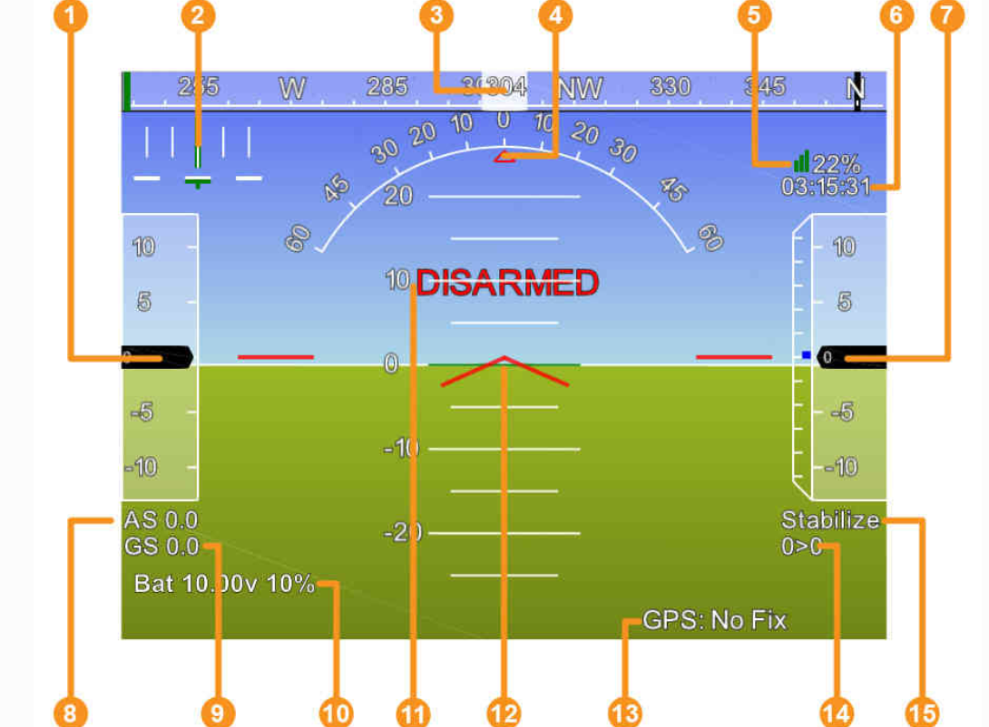
MISSON PLANNER
Air speed
Crosstrack error and turn rate
Heading direction
Bank angle
Telemetry connection link
quality GPS time
Altitude
Air speed
Ground speed
Battery status
Artificial Horizon
Aircraft Attitude
GPS Status
Distance to Waypoint > Current Waypoint Number
Current Flight Mode

Slide 15
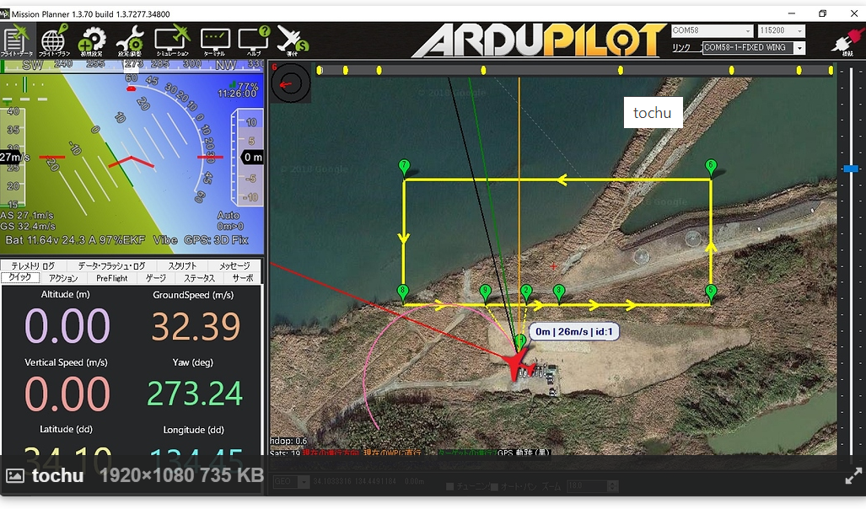
Choosing the drone's flight route and coordinates

Slide 16
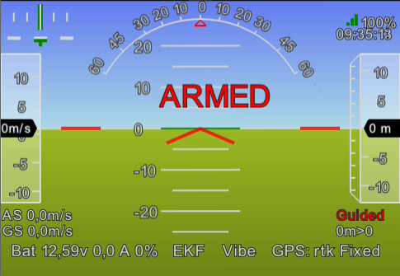
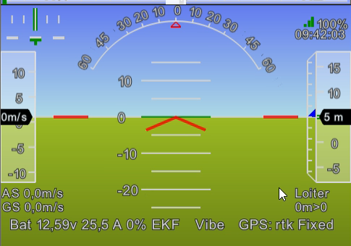
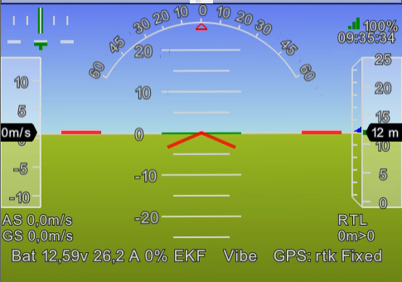
PROCESS BACKGROUND FOR FLIGHT
Take Off and Take Arm
-Guided Mode
Automatic Path Flight
-Auto Mode
Escaping Obstacle
-Loiter Mode
Return Automatic Path Flight
-Auto Mode
….
….
Return to Home
-RTL Mode

Slide 17
Tests
Computer Vision Software Test
Hardware Tests
Autopilot Software Tests

Slide 18
Computer Vision Software Test
Object Detection Test
How Long Does It Take to Detect (FPS)
Accuracy Rate
Detection Distance
Color Detection Test
Commanding Accuracy Test

Slide 19
Hardware Tests
Signal Performance Test
Flight Speed Test
Battery Health Test
Vibration Test
Flight Time Test
Camera Test
GPS Test

Slide 20
Autopilot Software Tests
SDK Test for Simulation
Command Receive Accuracy Test
Axiom Truth Test
Command Receiving Test from Different Devices
Autopilot Flight Test
PID Test
SDK
Direction Test of Motors
Calibration Test of Gyroscope
Compass Calibration Test

Slide 21
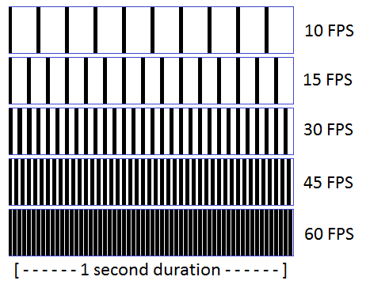
How Long Does It Take to Detect (FPS)
When we ran the trained model on Jetson, we got 2.5 fps, which was too low for our obstacle
detection. For a successful detection, the fps value must be above 10. As a solution, we decided
to use YOLOv4-tiny instead of using YOLOv4. YOLOv4-tiny is faster and easier to train than YOLOv4.
It took us about 13 hours to train a model in YOLOv4, and the model that wasn't working properly
was causing this time to be completely wasted. YOLOv4-tiny will fail compared to YOLOv4, but the
difference is not much. This is very sufficient and very advantageous for our project, as a result
of which we increased the fps value to 5. Afterwards, we achieved a very important difference
by using TensorRT and activating the cuda cors after our research, since it was still insufficient,
and we reached 15 fps. So we made this case successful.

Slide 22
Accuracy Rate
After training the first models, the resulting model had poor accuracy and in some cases made
false detections. We identified the problem by training new models to find out the reason. Since
the data we used in our training was 2-dimensional, it had very few features and could be
detected in many places and could produce false results. Therefore, we decided to use more
specific and more feature-rich objects as data. Thus, as a result of our trials, we were successful.

Slide 23
Battery Health Test
We connected the batteries one by one to our device, which checks the battery health, and
checked the health status. When we found that one of the test batteries was faulty, we
replaced it.

Slide 24
PID Test
After doing the PID test when we first took the plane, we were still having problems with the
vibration and balance of the drone while flying, even we dropped the drone and broke the
propeller. The reason for this was the shape of our battery. The drone's center of gravity was
constantly changing. For this reason, new PID calibration was required. We have provided the
solution to this by adjusting the structure of the battery horizontally.

Slide 25
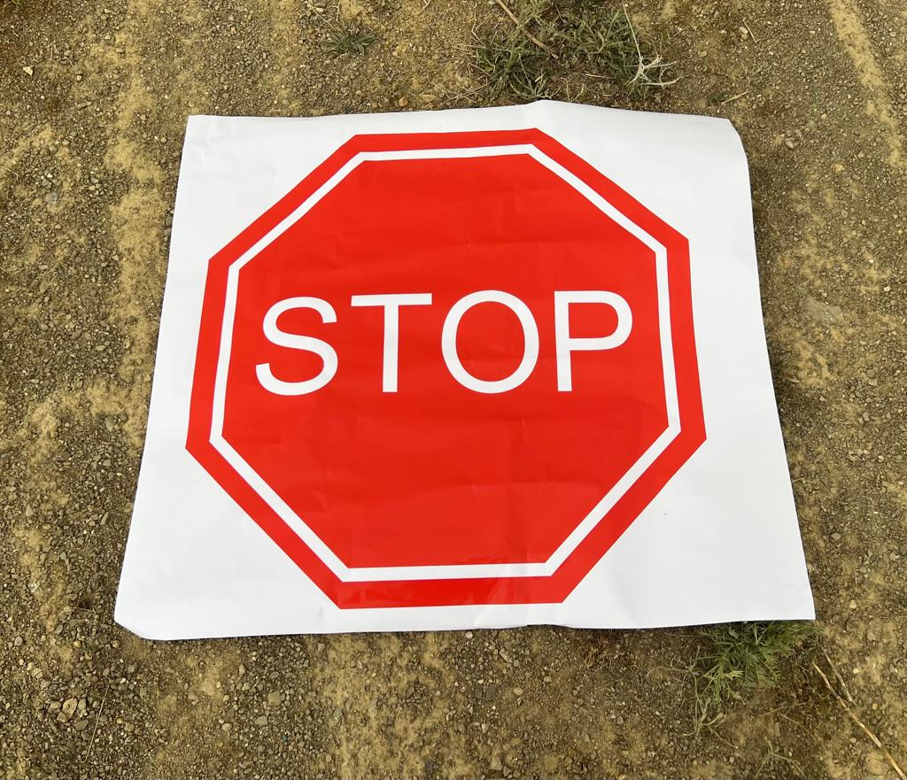
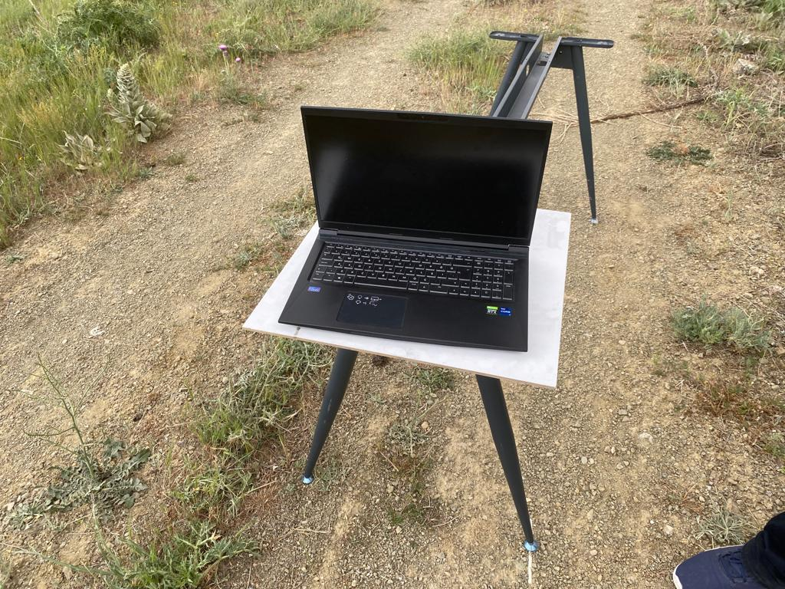
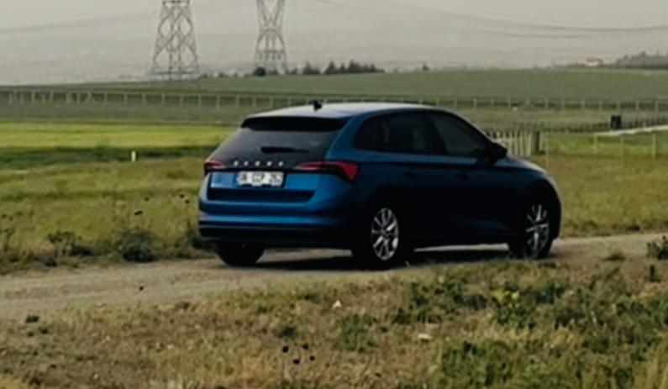
Obstacles

Slide 26
DEMO VIDEO
https://youtu.be/SwQerxFRkj0

Slide 27
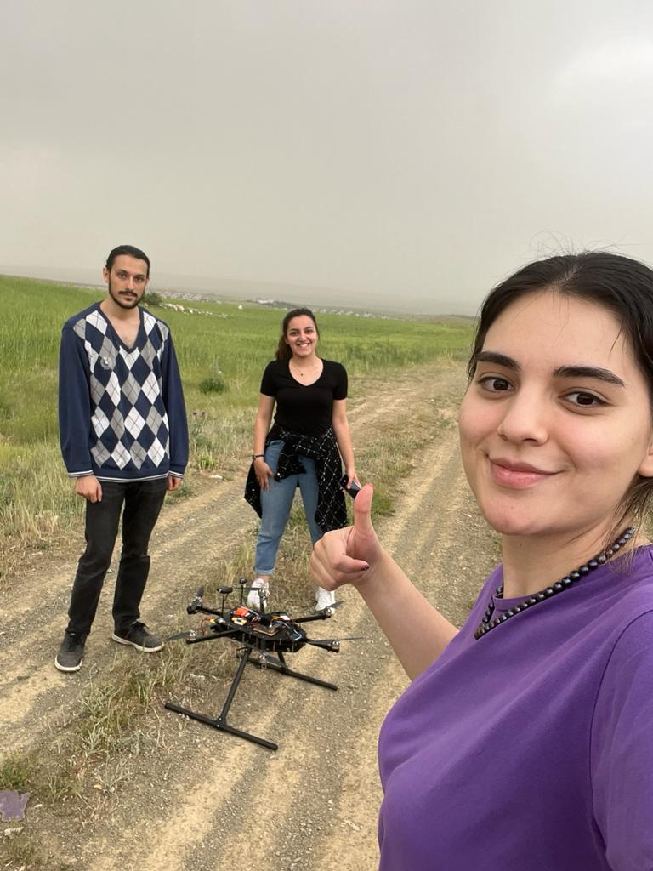

THANK YOU FOR LISTENING

